Slide 1
PA 3
Space Something-or-Other
Brooks Schafer and Melinda McElveen

Slide 2
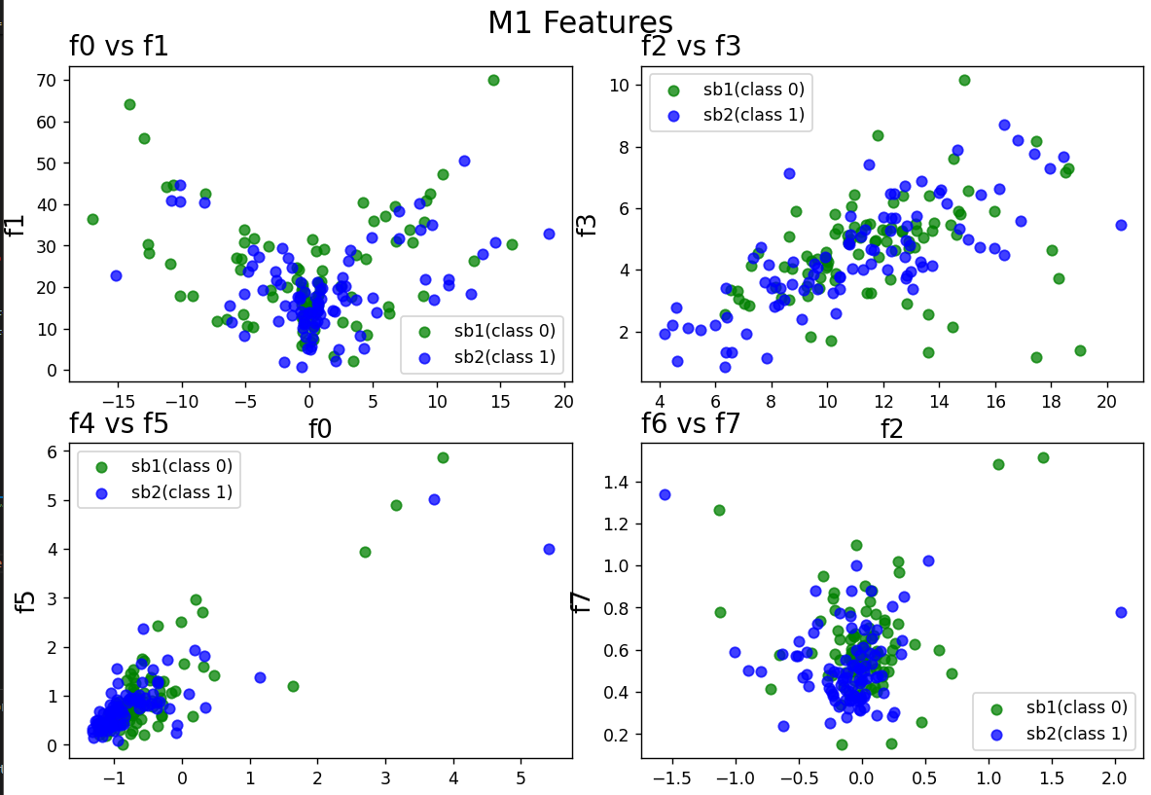
Output

Slide 3
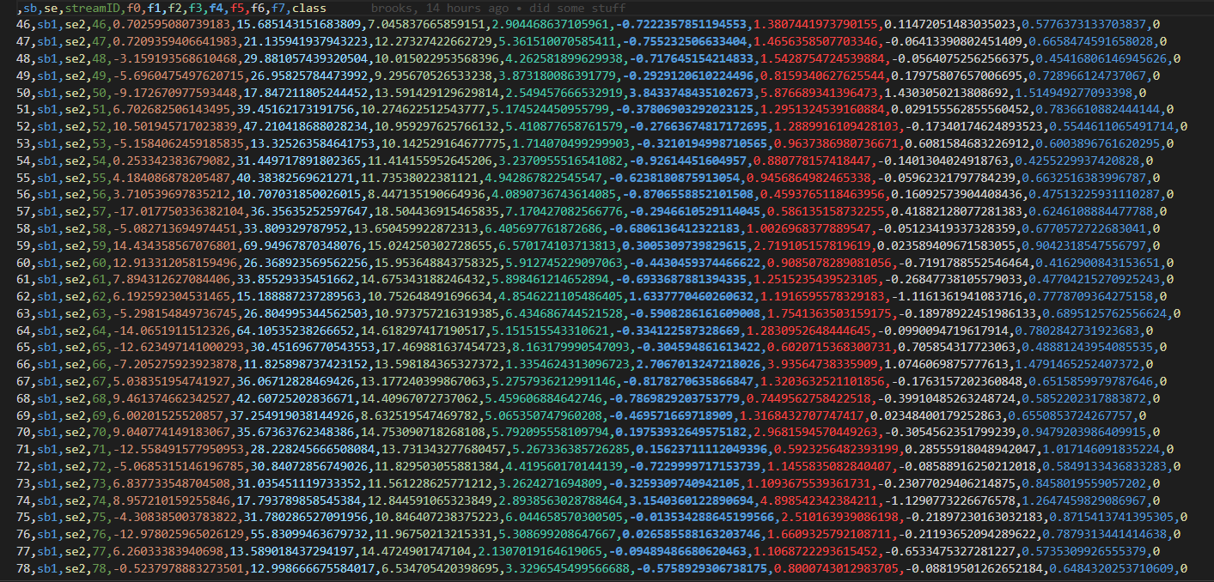
Testing Data

Slide 4
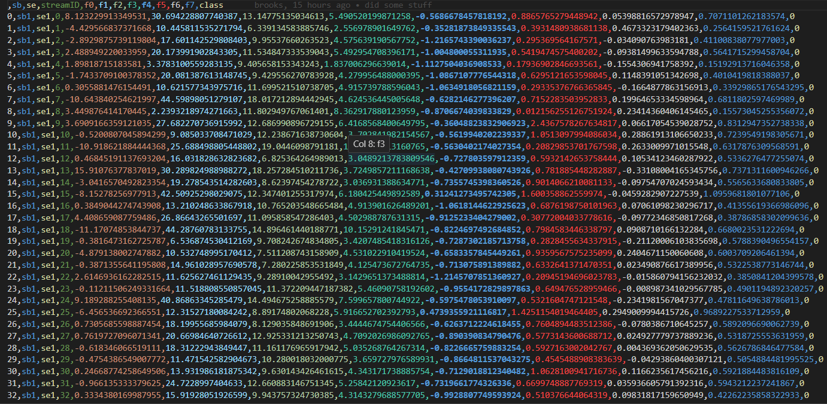
Training Data

